Slide 1
Exam Review
Digital Photography

Slide 2
Plan for today…
Review for exam

Slide 3
During Review…
Fill out study guide sheet with info you need to know.

Slide 4
The Test
Part 1- Written Test (50 points)
Part 2- Photo Assignment (50 points)

Slide 5
Part 1
Written Test (50 points)
5 Written Response Questions
Worth 10 points each
Graded with a rubric

Slide 6
Part 2
Photo Assignment (50 points)
1 Photo taken in class, edited in Photoshop and uploaded to Schoology.
10 points- Content (Photograph shows understanding of concepts)
10 points- Technical quality (exposure, focus, white balance, etc)
10 points- Composition (uses a compositional strategy, composition aids design, no distractions, etc)
10 points- Creativity (emotional impact, unique perspective, thought, planning)
10 points- Photoshop skills (ability to use quick selection tool, layers, masks, adjustment layers, save to .jpeg)

Slide 7
Photo Assignment
Demonstrate concepts learned in class
Use compositional strategies
Show creativity
Edit it a certain way in Photoshop using quick selection tool, adjustment layers and masks (no instructions!)

Slide 8
What will be on the test…
Composition
Exposure Triangle & Camera settings and how they affect your photograph (shutter, aperture, iso)
Famous Photographers
Elements and Principles
Photoshop

Slide 9
Composition

Slide 10
COMPOSITION
The PLACEMENT, ARRANGEMENT, or ORGANIZATION of elements in a photograph.
“Composition” = “putting together”

Slide 12
Rule of Thirds
Place subject of your photo on an imaginary rule of thirds line, or where they would intersect.

Slide 13
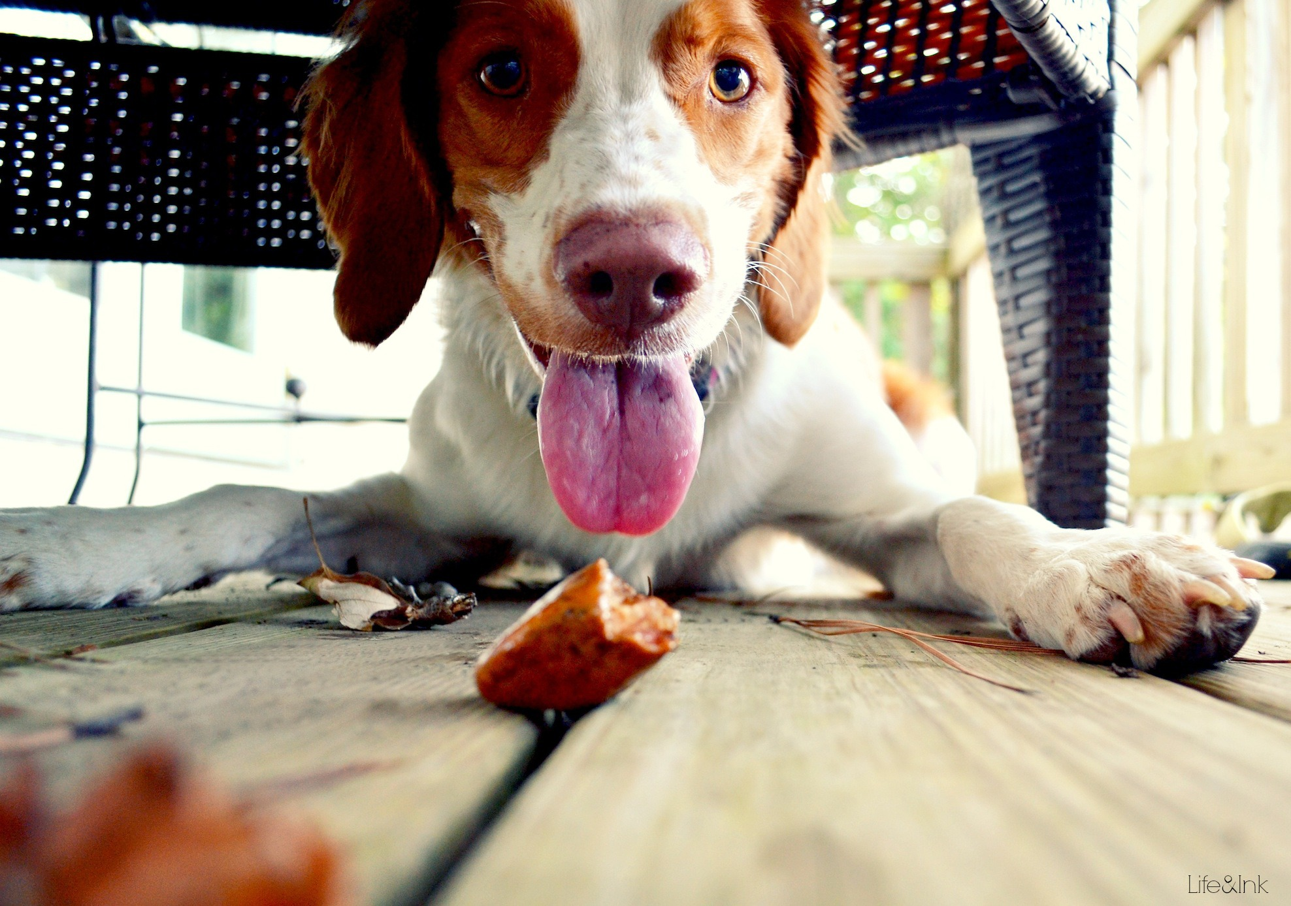
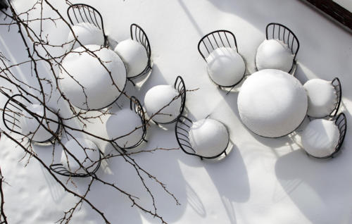
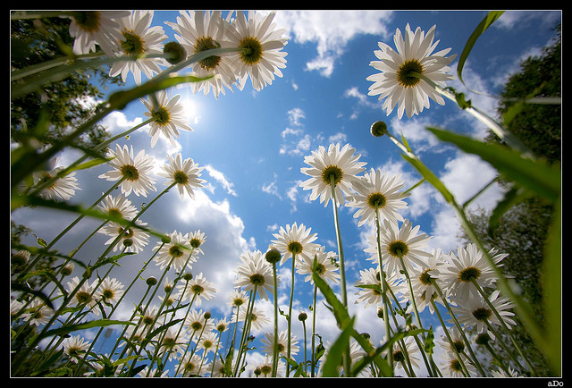
Point of View
The angle or position from which the camera views the subject.
Can be from above, below or an unusual position to add interest.

Slide 14
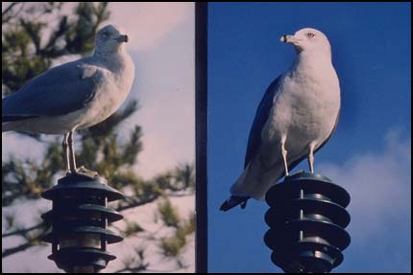
Simplicity
Removing unnecessary elements from you composition, so as to focus on the subject.

Slide 15
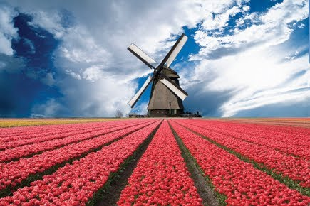
Leading lines
LEAD the viewer’s eye to your subject.
Lines alone, that do not lead your eye anywhere, are not leading lines.

Slide 16
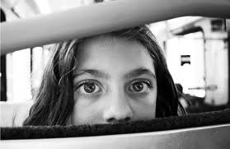
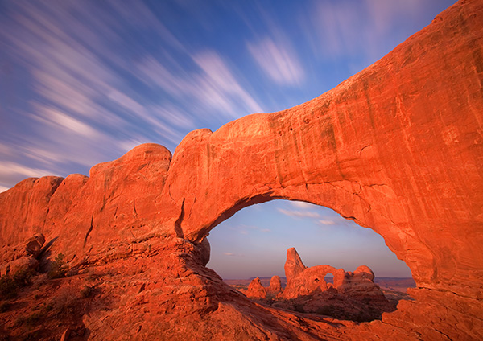
Framing
Surrounding your subject on one or more sides with another element.
Brings your attention in.

Slide 17
Leading Lines
LEAD the viewer’s eye to your subject.
Lines alone, that do not lead your eye anywhere, are not leading lines.

Slide 18
Exposure Triangle

Slide 19
What is exposure?

Slide 20
Amount of LIGHT collected by the sensor

Slide 22
What determines exposure?

Slide 26
LIGHT

Slide 27
LIGHT

Slide 28
Elements of Exposure

Slide 30
Aperture
A device that controls the amount of light admitted through an opening.
Bigger opening = more light
Smaller opening = less light

Slide 32
Size of opening measured in “f-stops”

Slide 33
Aperture Controls two things:

Slide 34
Aperture Controls two things:
1. EXPOSURE

Slide 35
Aperture Controls two things:
1. EXPOSURE
2. DEPTH OF FIELD

Slide 36
DEPTH OF FIELD

Slide 39
Shutter Speed
The device on the camera that opens and closes to control how long the digital sensor is exposed to light!
Like a “door” that opens and closes.
Shutter speed = how long the shutter is open for.
Longer time = more light
Shorter time = less light

Slide 41
Shutter speed controls 2 things:

Slide 42
Shutter speed controls 2 things:
EXPOSURE

Slide 43
Shutter speed controls 2 things:
EXPOSURE
How MOTION is CAPTURED

Slide 46
ISO
A measurement that describes the image sensor’s sensitivity to light.
When it is dark or there is not a lot of light, you can increase the ISO to make the sensor more sensitive.
When there is plenty of light available, you can decrease the ISO to make it less sensitive.

Slide 48
ISO controls 2 things:

Slide 49
ISO controls 2 things:
EXPOSURE

Slide 50
ISO controls 2 things:
EXPOSURE
IMAGE QUALITY (noise)

Slide 51
Noise
The occurrence of color dots or specks where there should be none.
Caused by HIGH ISO

Slide 54
Balancing all 3…

Slide 55
Av (aperture value) Mode

Slide 57
Depth of field
The RANGE or DISTANCE in a photo that appears SHARP and IN FOCUS.

Slide 59
Large Depth of field
Everything is in focus-near and far.
Good for landscapes or when you have important elements in the foreground and background.

Slide 60
Shallow Depth of Field
Only a shallow distance is sharp, the rest is blurred out.
Good for isolating your subject and simplifying your background.
Good for portraits or drawing attention to your subject.

Slide 61
3 WAYS TO AFFECT DEPTH OF FIELD!

Slide 62
To create SHALLOW depth of field:

Slide 63
To create SHALLOW depth of field:
1. LARGE APERTURE (lower f-stop #)
2. LONGER FOCAL LENGTH (zoom-in)
3. POSITIONING
Get your camera closer to the subject.
Move your subject farther in front of your background.

Slide 64
To create LARGE depth of field:

Slide 65
To create LARGE depth of field:
1. SMALL APERTURE (higher f-stop #)
2. SHORTER FOCAL LENGTH (zoom-out)
3. POSITIONING
Move your subject farther away from your camera.
Move your subject closer to the background.

Slide 66
Tv (Time Value)

Slide 67
Tv Auto Exposure Mode
Spin the dial to change your shutter speed.
Your camera will automatically select the appropriate size aperture to properly expose your image.

Slide 69
Elements and Principles

Slide 70
What are they???

Slide 72
=
.

Slide 73
.
“Building Blocks” of Art

Slide 77
TEXTURE

Slide 80
Space

Slide 82
color

Slide 85
VALUE

Slide 86
Value
The lightness or darkness
Gray scale or color
Especially important in black and white photography

Slide 89
SHAPE & FORM

Slide 90
Shape- 2D

Slide 91
Form- 3D

Slide 93
How the art elements are arranged in a composition.

Slide 94
How the building blocks are PUT TOGETHER!!!!

Slide 96
RHYTHM- creates eye movement

Slide 97
Pattern/Repetition

Slide 98
Pattern- Exact Duplication of Elements

Slide 99
Repetition- Near Duplication or Duplication with Variety

Slide 100
CONTRAST

Slide 102
UNITY

Slide 103
Unity: Simplicity
Keep it simple!
Limit the shapes, colors, lines, so there ISN’T a lot of variety.
Think about when you’re getting dressed. An outfit that matches has unity.
If you pair plaid with stripes and polka dots, you DON’T have unity.

Slide 104
Unity: REPETITION
Repeating a similar line, shape, form, color, etc throughout the composition.
In this example- repeated lines in the branches.

Slide 105
Unity: PROXIMITY
Elements that are arranged close to one another create more unity than if they were scattered all of the composition with lots of space in between.

Slide 106
BALANCE

Slide 107
SYMMETRICAL

Slide 108
ASYMMETRICAL

Slide 109
EMPHASIS

Slide 110
Framing

Slide 111
Placement of Subject

Slide 112
Narrow Depth of Field

Slide 113
Contrast

Slide 114
Leading Lines

Slide 115
Famous Photographers & Artists
Muybridge
Stieglitz
Adams
Lange
Avedon
Hockney

Slide 116
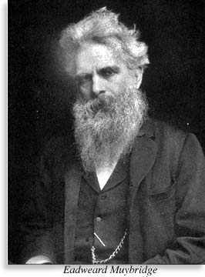
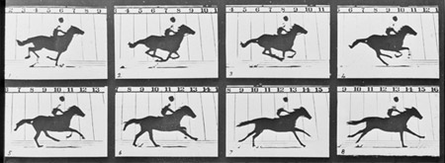
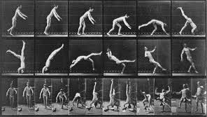
Eadweard Muybridge
First to photograph fast motion. (Freeze Action)
Allowed us to study movement.
Created the Zoopraxiscope, which eventually led to the first motion pictures.

Slide 117
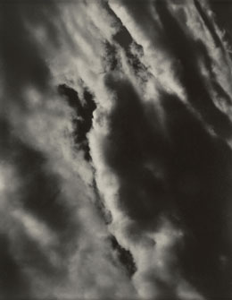
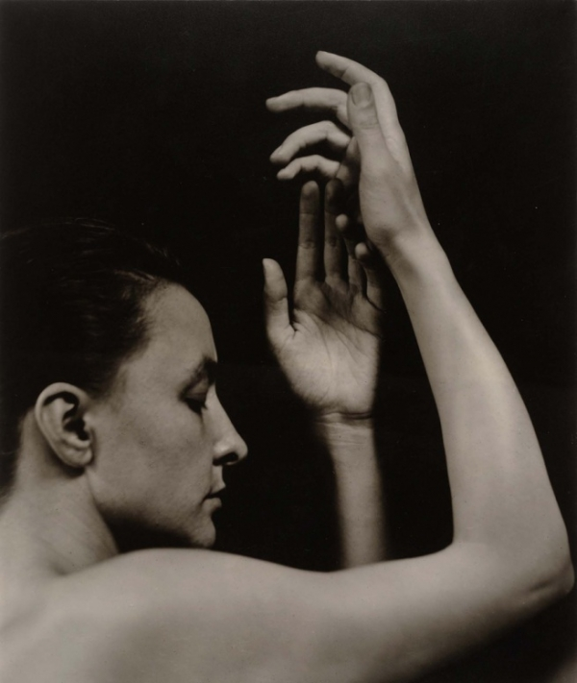
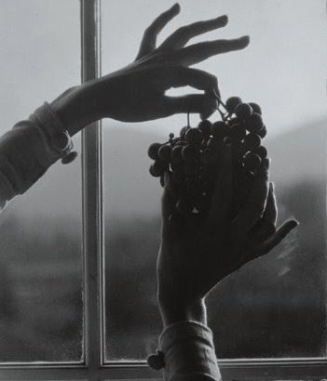
Alfred Stieglitz
City Scenes, Portraits of his wife, Georgia O’Keeffe, Hands, Clouds.
Opened his own art gallery in NYC.
ESTABLISHED PHOTOGRAPHY AS AN ART FORM!

Slide 118
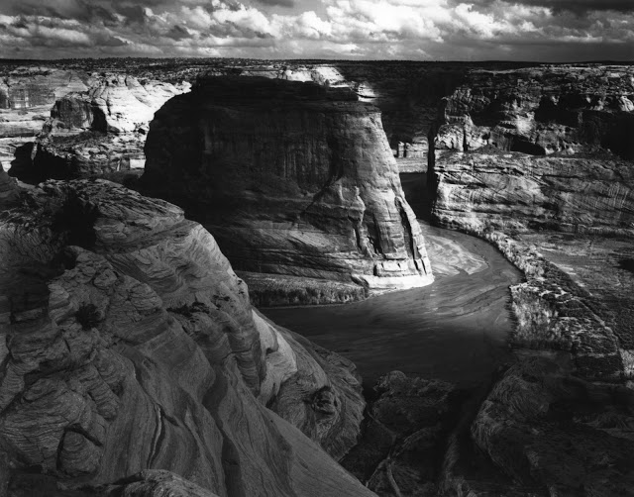
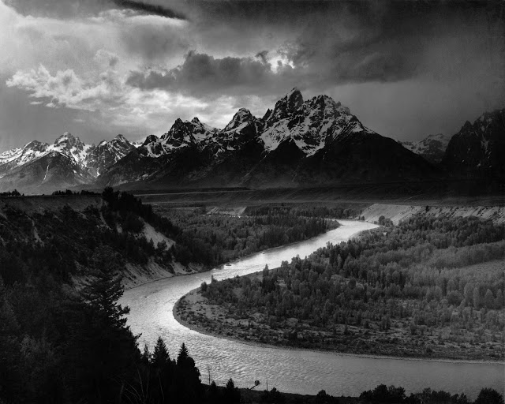
Ansel Adams
Landscape photographer of the American West
(Yosemite National Park)
Environmentalist & conservationist
Also helped photography become an accepted art form

Slide 119
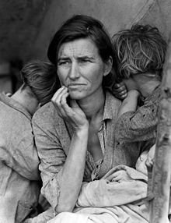
Dorothea Lange
Influential American documentary photographer and photojournalist.
“Migrant Mother”
Photographs humanized the consequences of the great depression
Influenced the development of documentary photography

Slide 120
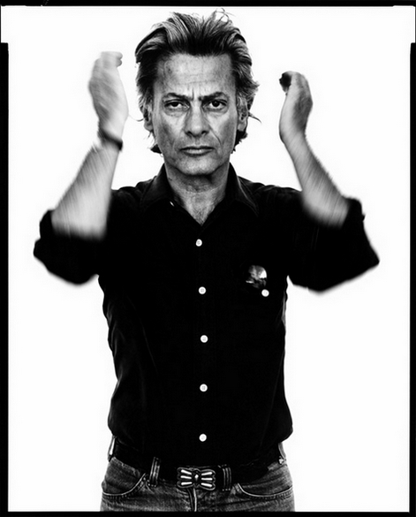
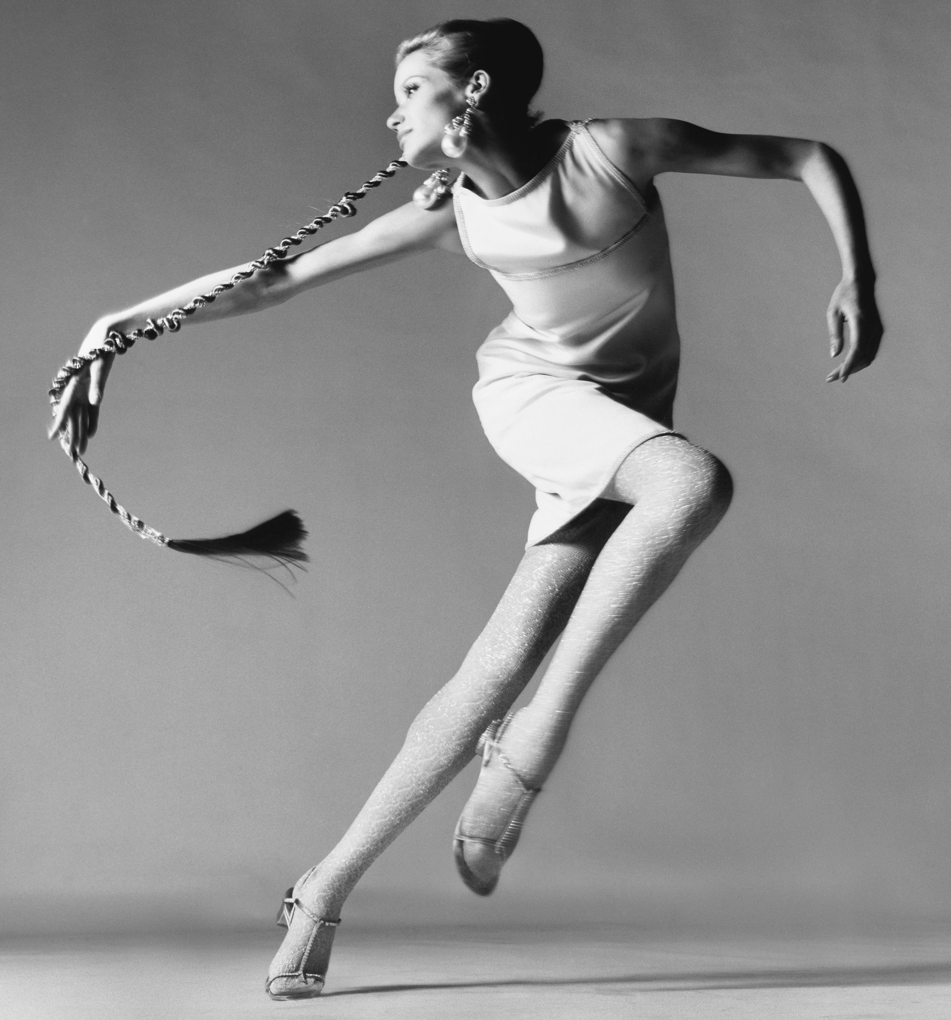
Richard Avedon
Fashion and portrait photographer
Revolutionized fashion photography with his use of movement and emotion
Known for his simplistic portraits with plain white backgrounds.
No fancy props or set ups, just the models as they are

Slide 121
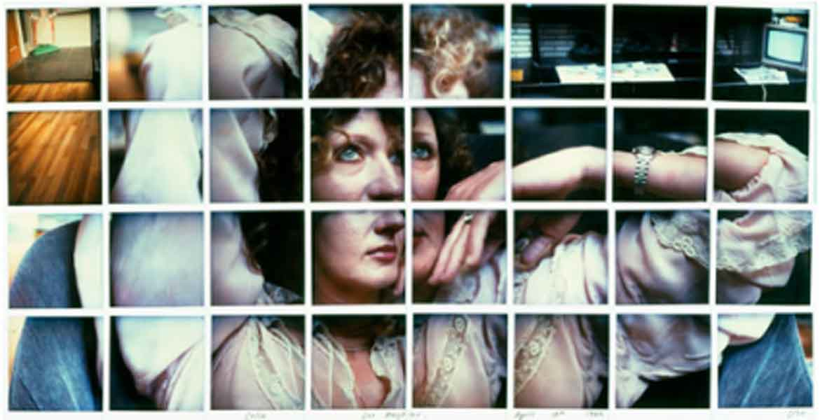
David Hockney
- Created photo collages called “joiners”
-Multiple viewpoints that are then pieced together.
-Interested in how we see and depict space and time.
- Interested in how we turn a 3D world into a 2D image.

Slide 122
Photoshop

Slide 123
Tools that we used…

Slide 125
Crop Tool

Slide 127
Quick Selection

Slide 129
Paint Brush

Slide 131
Layers Panel

Slide 134
Add Adjustment Layer Button

Slide 136
Layer Mask Button

Slide 137
What is a Mask?

Slide 138
Masks

Slide 139
What is an adjustment Layer?

Slide 140
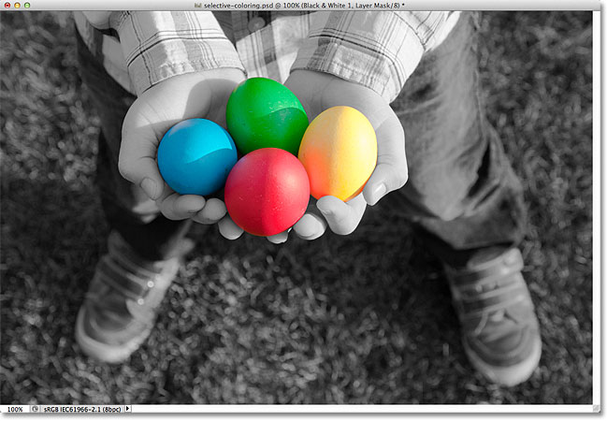

Slide 141
Any Questions??

Slide 142
What makes a photograph successful?

Slide 143
What makes a photograph successful?
Strong composition- leads your eye to the subject.
Creative, unique or moving concept, emotional impact
Strong technical skill
Effective use of elements of art / principles of design

